Slide 1

BACHELOR OF TECHNOLOGY IN
Artificial Intelligence and Machine Learning
Batch Number:GT-05
Project Guide : R.Karthik
Batch Names & Roll Numbers
R.Jyoshna(2111CS020194) B.Jyothi(2111CS020195)
T.Karthik Yadav(2111CS020201) P.Sandhya Kumari(2111CS020254) S.Mahaboob Vali(2111CS020257)
Department of AIML, School of Engineering
Malla Reddy University

Slide 2
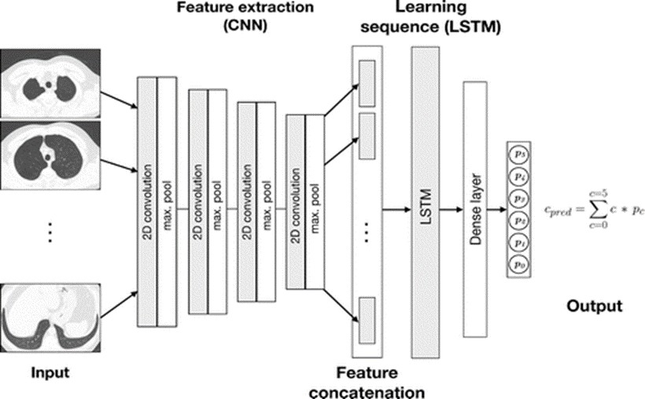
Early Classification Of Emphysema In CT Scans Using Deep Learning

Slide 3
Abstract:
This project aims to develop a deep learning-based system for the early classification of emphysema using CT scans. Emphysema is a progressive lung disease characterized by the destruction of lung tissue, often leading to significant morbidity and mortality if not detected early. Current methods for emphysema detection rely heavily on manual interpretation by radiologists, which can be time-consuming and prone to variability. Leveraging advancements in deep learning techniques, our proposed system will automatically analyze CT scans to identify and classify regions indicative of emphysematous changes. By providing early and accurate classification of emphysema, this system has the potential to improve patient outcomes by enabling timely interventions and treatment strategies.

Slide 4
Problem Statement:
This project addresses the overfitting challenge in early classification of emphysema using CT scans with deep learning techniques. By implementing strategies such as data augmentation, regularization techniques (e.g., dropout), and model architecture optimization, the aim is to mitigate overfitting while maximizing the model's ability to generalize to unseen data. Through careful experimentation and validation, the developed system seeks to provide reliable early classification of emphysema, thus improving patient outcomes by enabling timely interventions.

Slide 5
INTRODUCTION:
The project focuses on the early classification of emphysema in CT scans using deep learning techniques, specifically employing the DenseNet121 algorithm. Emphysema, a progressive lung disease, necessitates early detection for effective intervention. Leveraging DenseNet121's sophisticated architecture, the aim is to develop a precise deep learning model capable of accurately identifying emphysematous lung tissue patterns in CT images. Through meticulous data preprocessing, model training, and validation, the objective is to create a robust tool for clinicians to detect emphysema in its incipient stages, facilitating timely treatment and improving patient outcomes.

Slide 6
Existing Methodology:
Deep CNNs like VGGNet and ResNet are susceptible to overfitting, especially with increasing model depth due to a large number of parameters.
MS-ResNet (Modified Supervision Residual Network) may exacerbate overfitting due to its complex architecture and numerous parameters, despite introducing supervision at intermediate layers to improve gradient flow.
Inception Networks, including GoogLeNet and InceptionV3, designed with multiple parallel convolutional pathways, may suffer from overfitting when datasets lack diversity to capture complex features.
Custom CNN architectures tailored to specific tasks or datasets can encounter overfitting if not properly regularized or trained with sufficient data.
Transfer Learning is Leveraging pre-trained models and fine-tuning with frozen layers to transfer knowledge from larger datasets.
Increased Labeled Data is Collecting more labeled training data to provide the model with a richer understanding of the task.
Semi-Supervised Learning is Incorporating unlabeled data into training to augment labeled dataset size and improve model generalization.

Slide 7
Proposed Methodology:
The proposed methodology emphasizes fine-tuning DenseNet121 specifically for emphysema patterns, detailing tailored preprocessing steps, validation, and interpretation techniques. It highlights the adaptation of DenseNet121's architecture for the task, optimizing hyperparameters and testing for early classification capabilities. The proposed approach delves deeper into DenseNet121's utilization, aiming for enhanced performance and understanding in emphysema detection, while the existing methodology primarily utilizes the model without explicit optimization for the task.

Slide 8
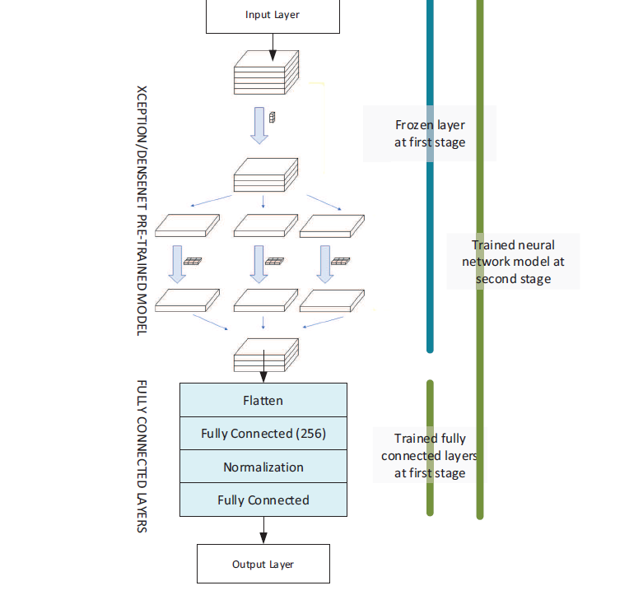
Architecture:

Slide 9
Algorithms:
Convolutional Neural Networks (CNNs):CNNs are commonly used for image classification tasks due to their ability to automatically learn features from images.
Data Augmentation: Techniques such as rotation, flipping, and scaling of images to increase the diversity of training data and improve model generalization.
DenseNet: DenseNet121 is a CNN architecture that connects each layer to every other layer in a feed-forward fashion, which can be beneficial for learning intricate patterns in medical images. DenseNet-121 would have been used to automatically learn relevant features from the scans and classify regions affected by emphysema.
Ensemble Methods: Combining predictions from multiple models to improve overall performance and robustness.

Slide 10
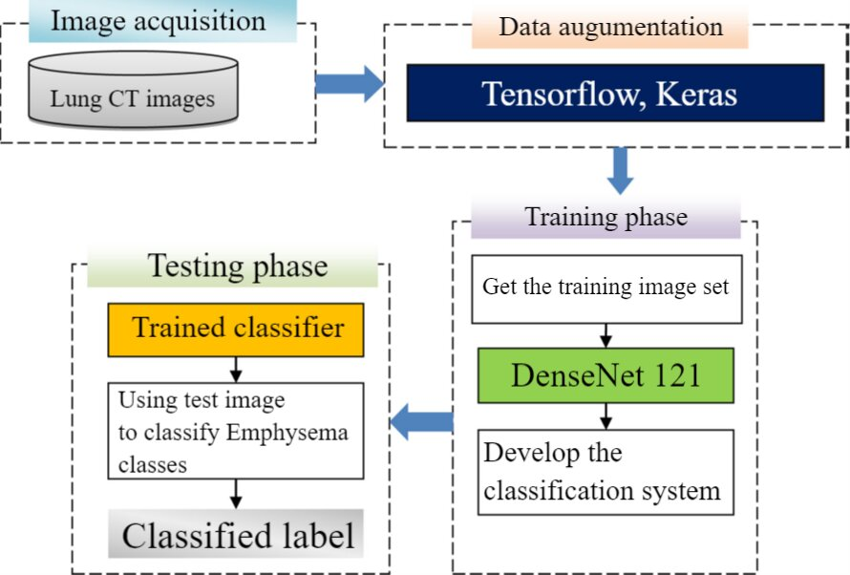
Flow Chart

Slide 11
Modules:
TensorFlow: TensorFlow is a machine learning framework developed by Google, used for building and deploying machine learning models, especially deep learning models.
Pillow (PIL): Pillow is a Python Imaging Library (PIL) fork that provides capabilities for opening, manipulating, and saving various image file formats.
CV2: OpenCV (Open Source Computer Vision Library) provides functions for image processing, computer vision tasks, and machine learning algorithms related to image analysis.
Numpy : NumPy is a fundamental package for scientific computing with Python, providing support for multidimensional arrays, matrices, mathematical functions, and more.
Scikit-learn : Scikit-learn is a machine learning library in Python that offers tools for data mining, analysis, and modeling, including a wide range of machine learning algorithms.

Slide 12
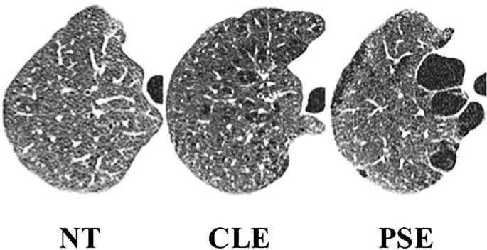
Matplotlib : Matplotlib is a plotting library for Python that provides functions for creating static, animated, and interactive visualizations, widely used for data visualization & analysis.
Keras : It is a user-friendly deep learning library in Python. It offers a simple interface for building neural networks and includes utilities for data preprocessing and model evaluation. It's widely used for training deep learning models and supports data augmentation through the Image Data Generator class.

Slide 13
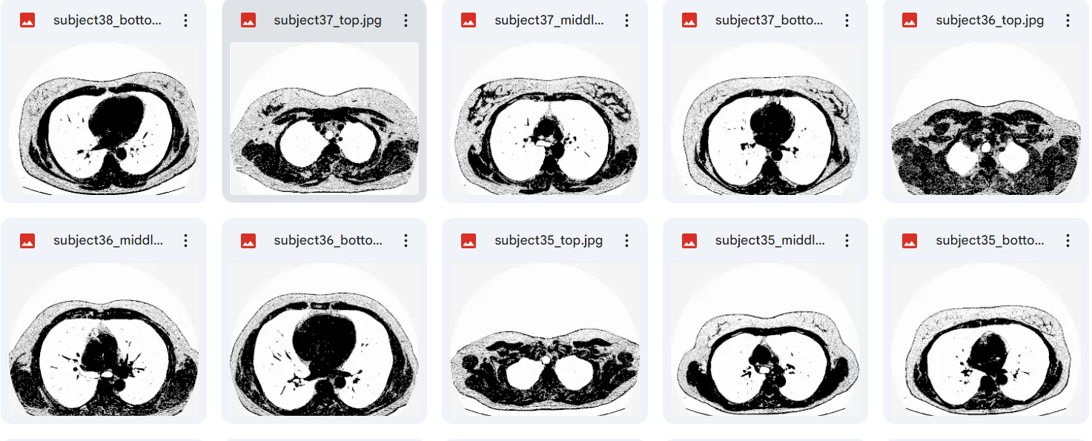
Output Screens: Image Dataset:

Slide 14
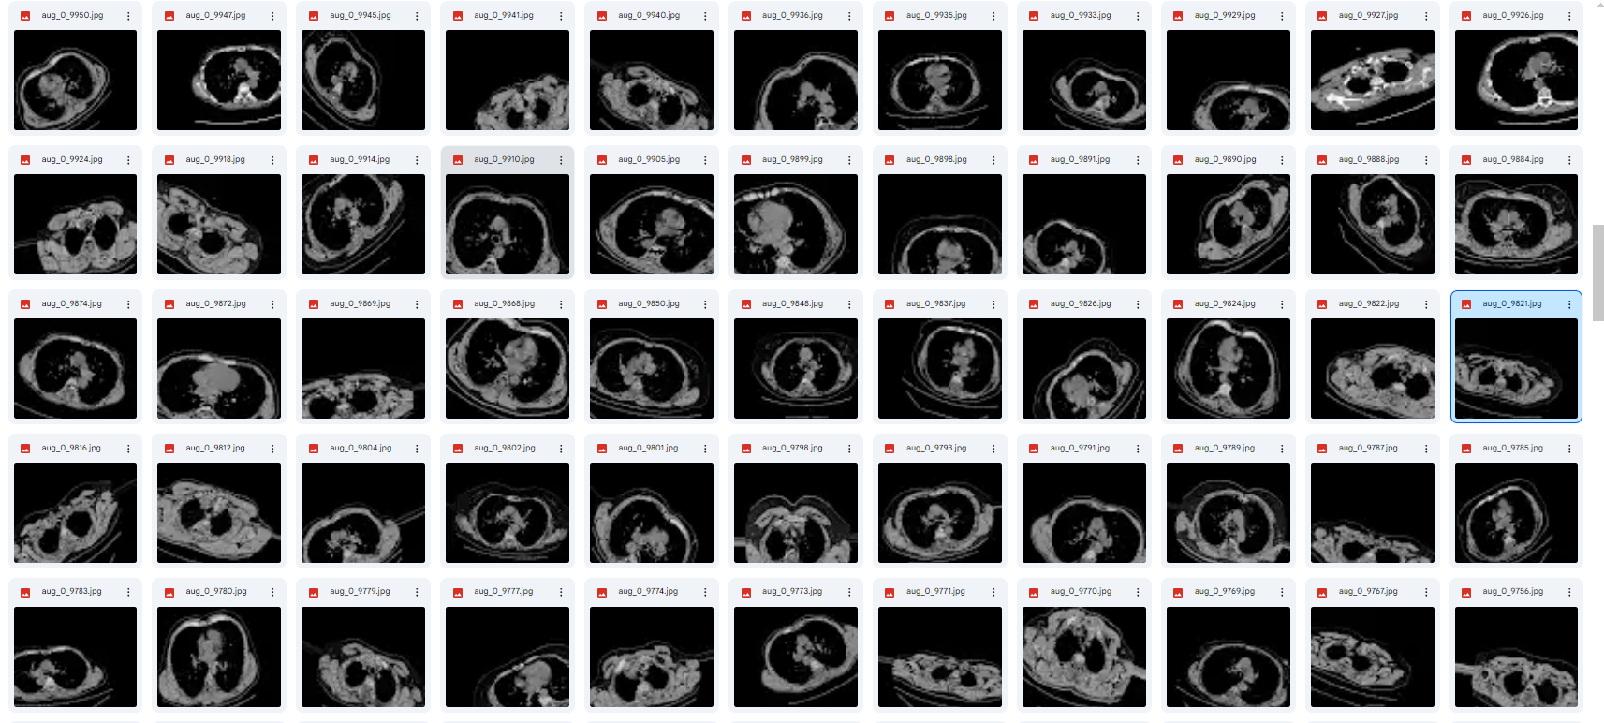
After the Data Augmentation:

Slide 15
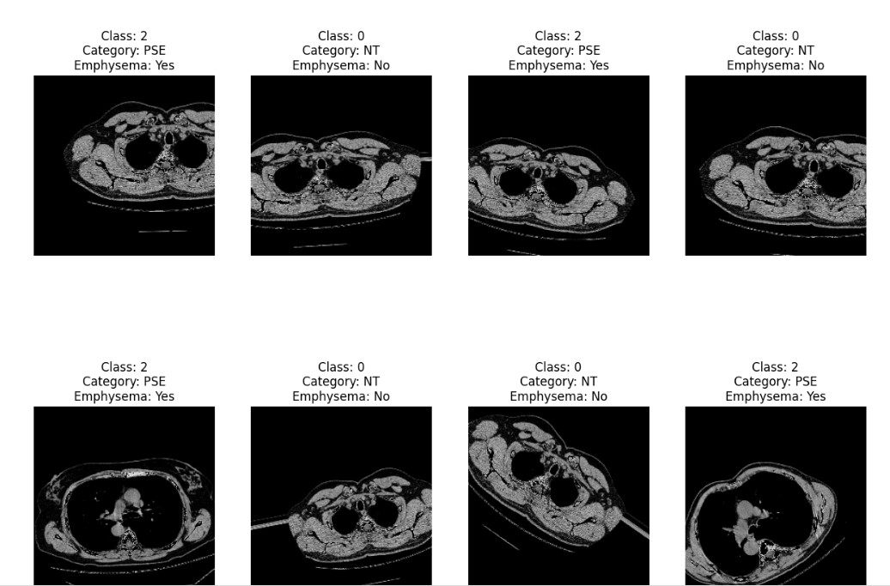
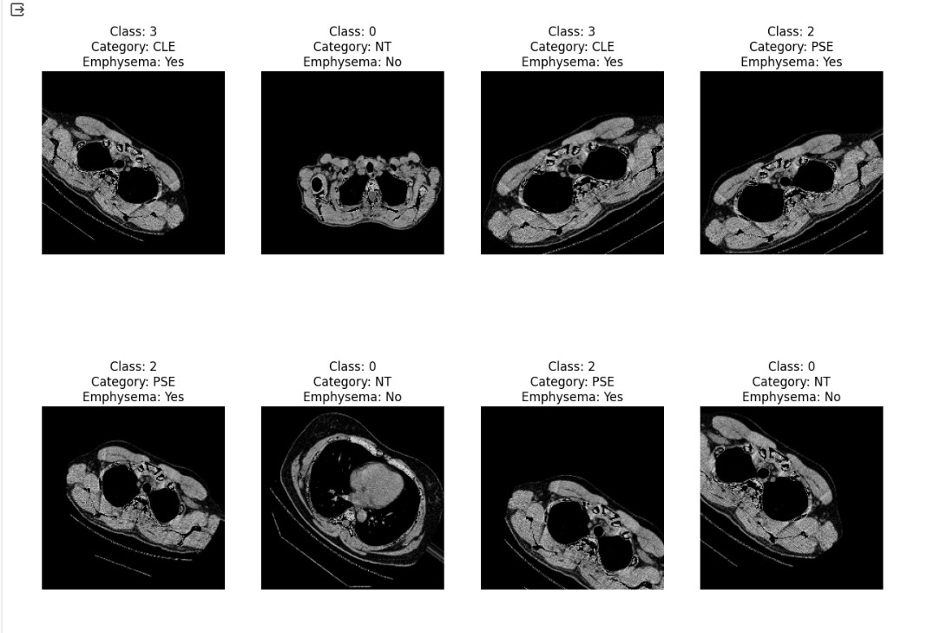
Fig:Emphyesema Detection Images

Slide 16
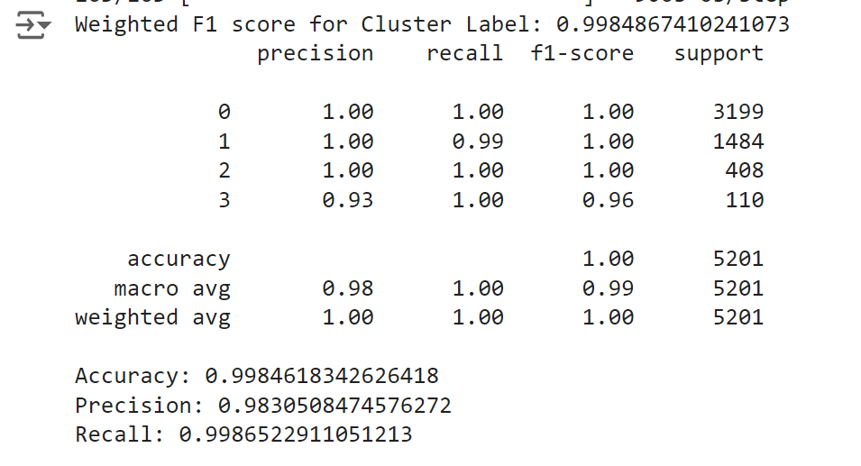
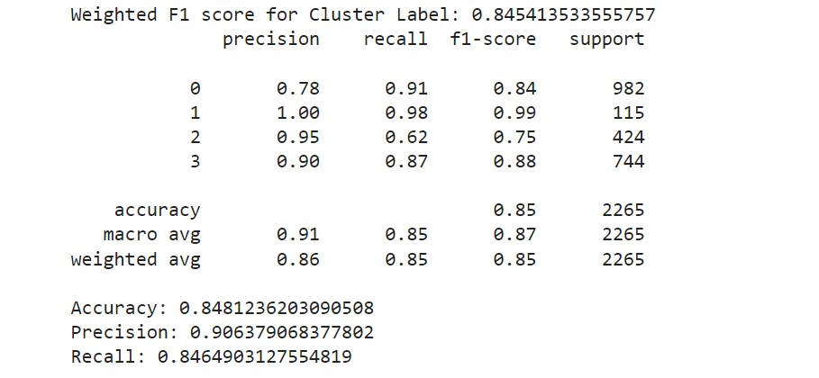
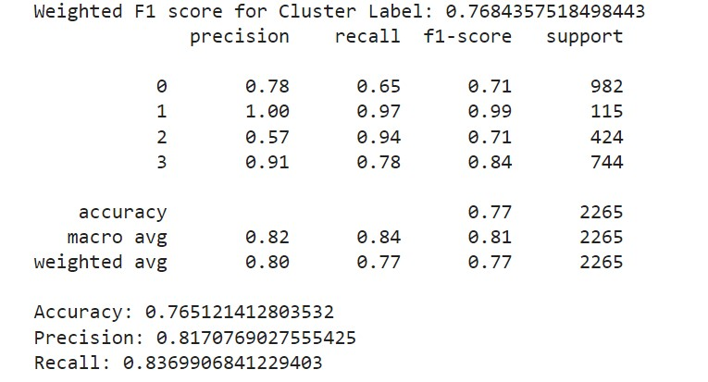
Fig: Classification report of V16 Model
Fig: Classification report of Densenet121 Model
Fig: Classification report of InceptionV3 Model

Slide 17
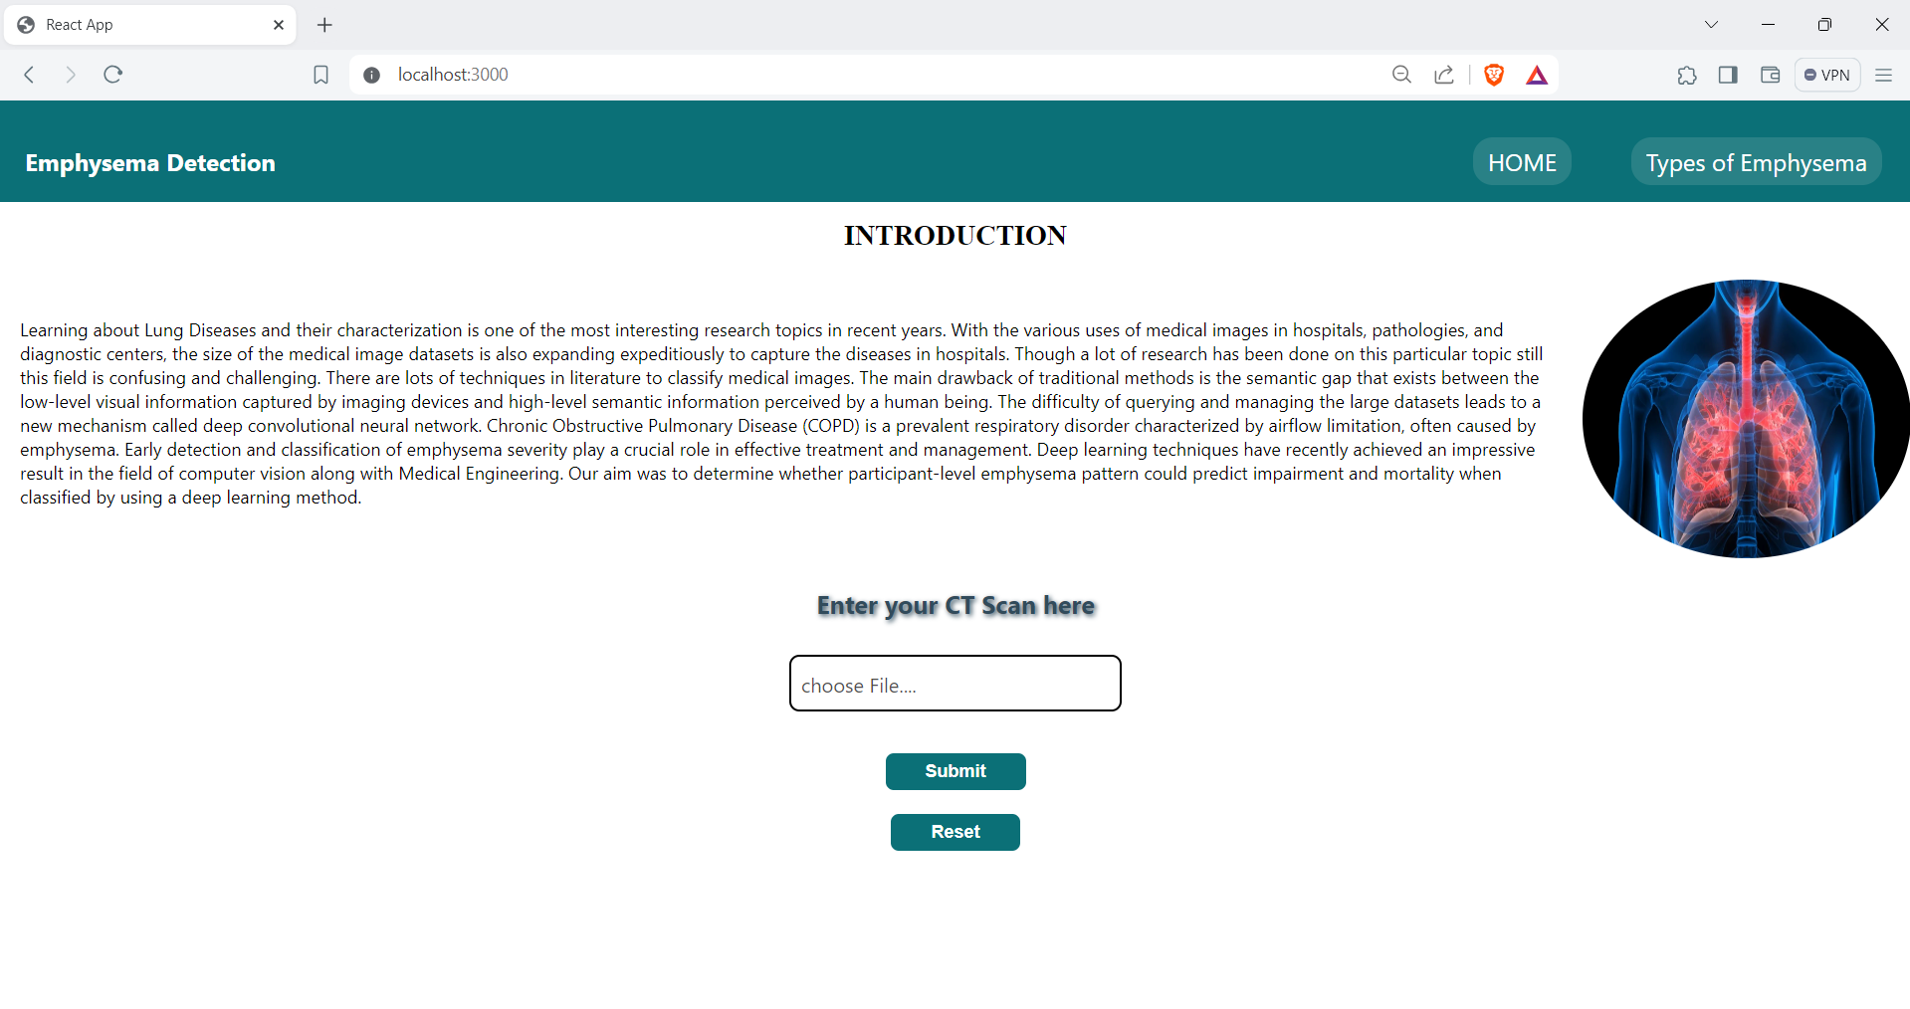
Web GUI’s Development & Integration
Fig: Front Page

Slide 18
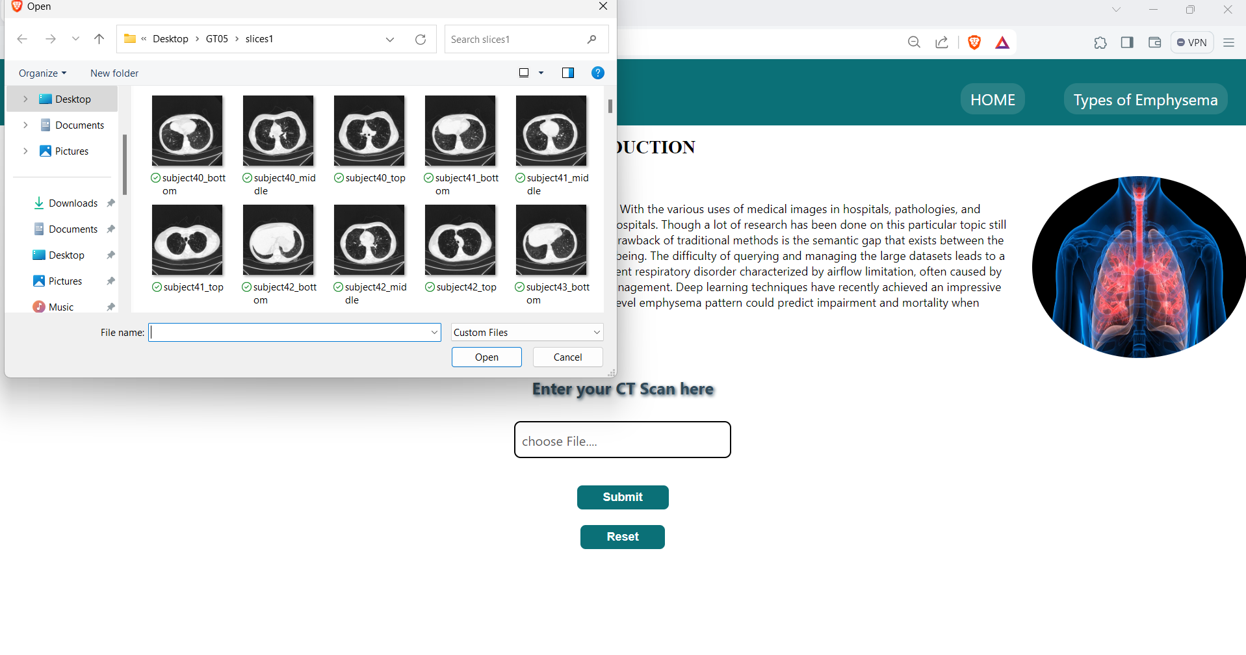
Fig:Upload CT Scan

Slide 19
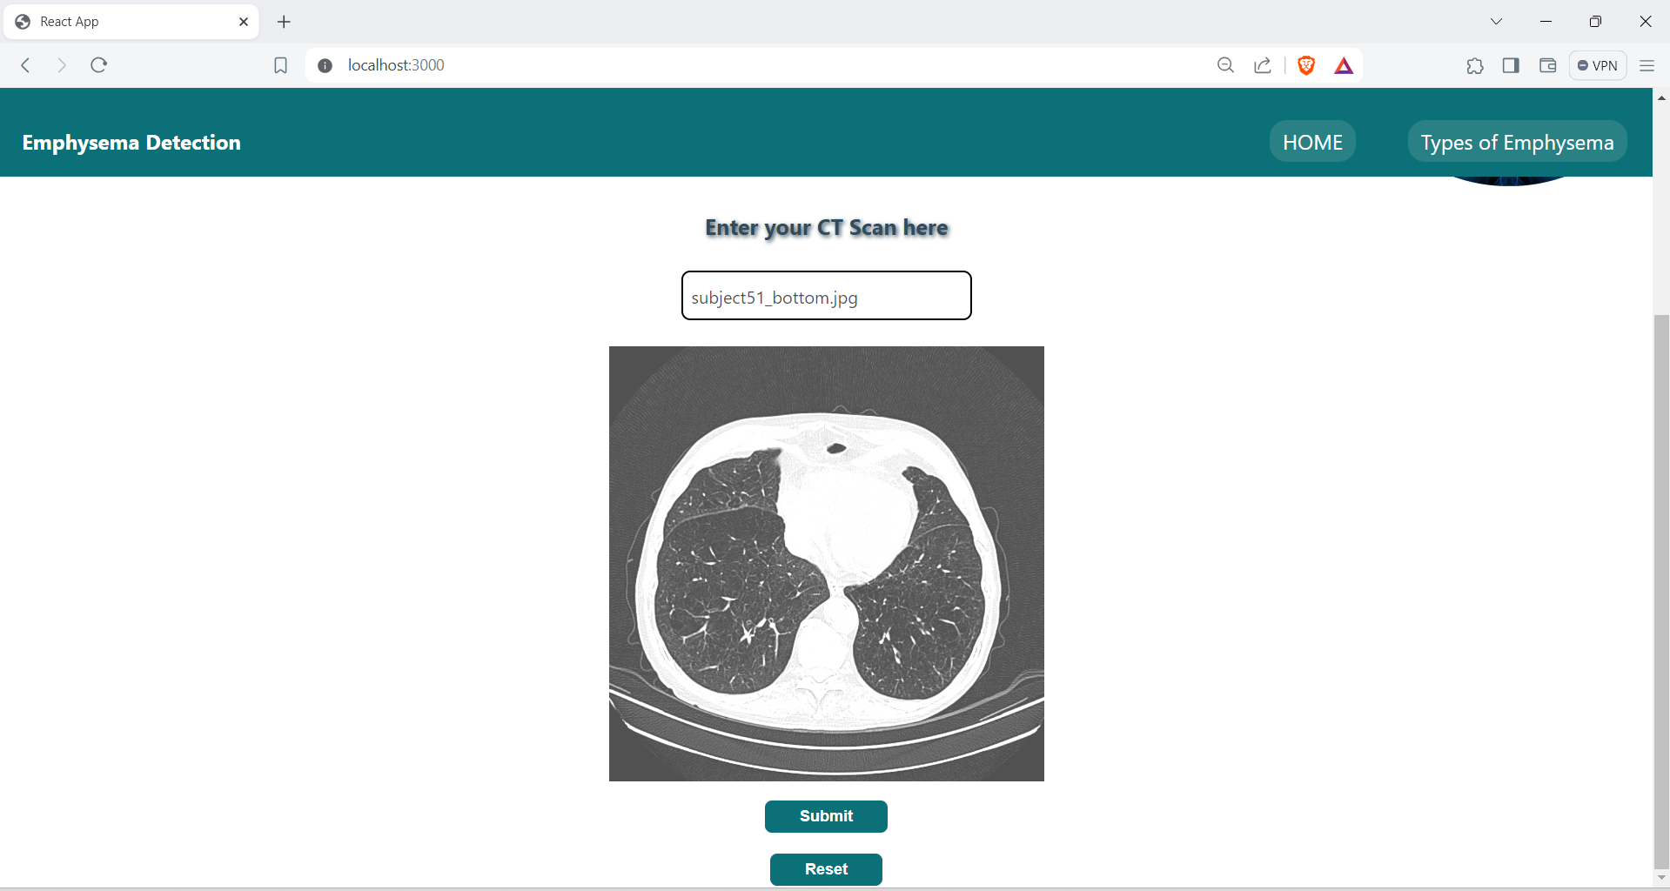
Fig: User upload their Image

Slide 20
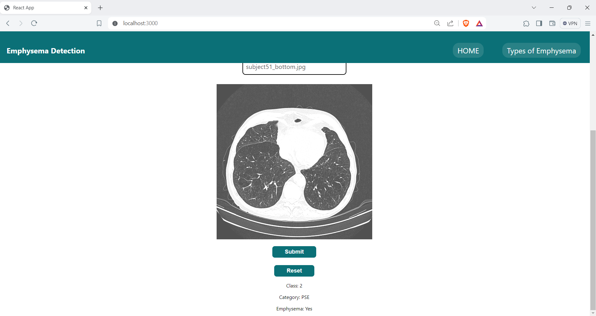
Fig:Output

Slide 21
Project conclusion
In conclusion, the emphysema detection project, leveraging deep learning techniques on CT scans, marks a significant advancement in respiratory health diagnostics. Through the fusion of deep learning algorithms and high-resolution CT imaging, the project has showcased remarkable efficacy in precisely identifying and characterizing emphysema-related anomalies within lung scans. This innovative approach not only aids in the early detection of emphysema but also offers insights into disease progression and severity. By harnessing the entirety of information provided by CT scans, including subtle structural changes and spatial distributions, the developed model demonstrates its potential to revolutionize clinical practice by providing accurate and timely diagnoses. Moving forward, continued refinement and validation of the deep learning models across diverse patient cohorts will be essential to ensure robust performance and widespread applicability in real-world healthcare settings. Ultimately, this project underscores the transformative impact of deep learning in advancing medical imaging and enhancing the management of respiratory conditions like emphysema.

Slide 22
Future Scope
In the realm of medical image analysis, particularly concerning lung diseases like Chronic Obstructive Pulmonary Disease (COPD) and emphysema, there exists a burgeoning interest in leveraging deep learning techniques for classification and prediction tasks. While traditional methods have made strides, they often grapple with the semantic gap between low-level visual information from imaging devices and high-level semantic understanding needed for accurate diagnosis. Deep convolutional neural networks (CNNs) have emerged as a promising solution to bridge this gap, showcasing remarkable results in computer vision and medical engineering. Looking ahead, future enhancements could encompass a multifaceted approach. Firstly, integrating multi-modal data sources such as CT scans, X-rays, and clinical records could provide a more holistic view of the disease. Transfer learning techniques may aid in adapting pre-trained models to specific lung disease classification tasks, potentially reducing the need for extensive annotated datasets. Moreover, incorporating methods for uncertainty estimation, explainability, and interpretability is crucial for building trust in these models among healthcare professionals. Longitudinal analysis could offer insights into disease progression over time, while advanced data augmentation and synthesis techniques could enhance model generalization. Additionally, exploring semi-supervised and weakly supervised learning approaches may leverage large amounts of unlabeled or weakly labeled data, making the development process more cost-effective. Ultimately, collaboration with medical experts and rigorous validation through clinical trials are paramount to ensuring the clinical relevance and efficacy of these deep learning models in improving patient outcomes and healthcare delivery

